Slide 1

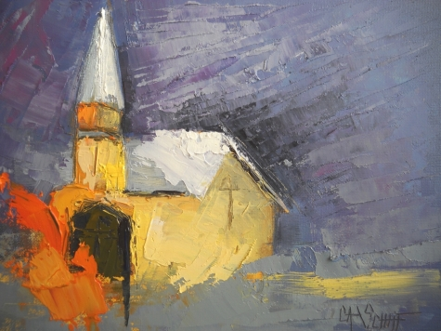


Making the Christian Community A Safe Place For Victims of Abuse
Philip G. Monroe, PsyD
Biblical Seminary
Global Trauma Recovery Institute

Slide 2
Objectives
pmonroe@biblical.edu www.wisecousel.wordpress.com
Understand the experience of abuse and trauma
Identify threats to emotional safety for trauma survivors in faith communities
Identify leader and church responses to care for adult victims of abuse

Slide 3
The redemption image
Isaiah 61
  Beauty for ashes
  Praise for heaviness
  Now called oaks of righteousness

Slide 4
Gospel in action?
Isaiah 42: What God does
  Justice to the nations
  Release captives from prison
  Bruised reeds not broken
  The blind guided over unfamiliar paths
  Rough places made smooth
James 1:27: Our response
  Religion that God our Father accepts as pure and faultless:

Slide 5
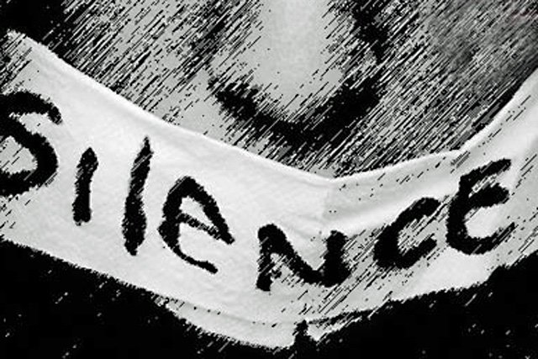
Survivor Experiences
Notes:
Image from: http://www.naasca.org/Graphics/Silence-drawing.jpg

Slide 6
Factors impacting trauma reaction
Background
Support
Traumatic Event
Level of Traumatic Response
Environment
Resilience Factors
Notes:
Gingrich 2011 presentation

Slide 7
Experiences as a child
Relational confusion
    (IDENTITY: Am I the cause of my abuse?)
Inability to predict or act toward future
    (POWER: What can I do?)
Decreased capacity to express self
    (VOICE: Will anyone listen?)

Slide 8
As an adult: TORN!
Depressed…BUT
    Panicked and anxious
Distrusting of others…BUT
    Self-loathing
Withdrawing…BUT
    Dependent

Slide 9
As an adult: TORN!
Emotionally shutdown…BUT
  Reliving
Reticent…BUT
  Impulsive
Afraid of the future…BUT
  Afraid of the past

Slide 10
Anxiety
Trauma
Depression
SHAME

Slide 11
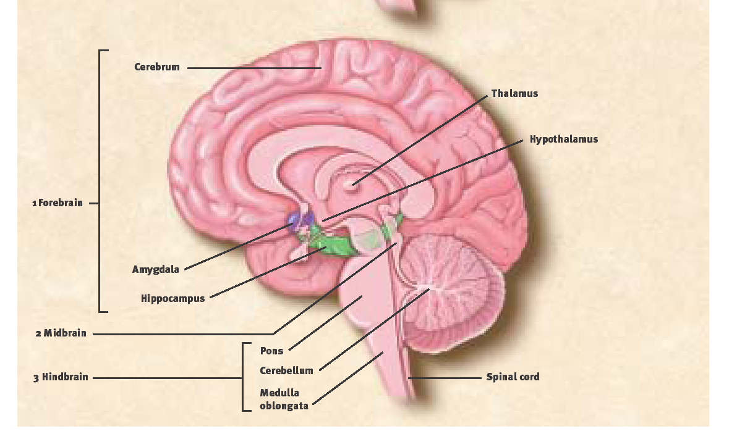
Is it all in my head?
Consciousness/thoughts
  Prefrontal cortex
Emotion processing
  Limbic systems
Flight/fight/freeze
  Brainstem

Slide 12
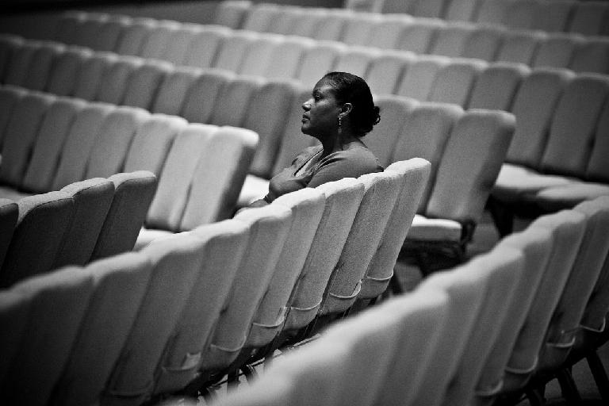
The church as Threat?
To people with invisible wounds
Notes:
Image taken from: http://4.bp.blogspot.com/-UDycjRWN38g/UJGa3JDk30I/AAAAAAAACzk/ESvQKSxXzos/s1600/SITTING+ALONE+AT+CHURCH.jpg

Slide 13
Question:
What are the dangers of having invisible wounds in the church?

Slide 14
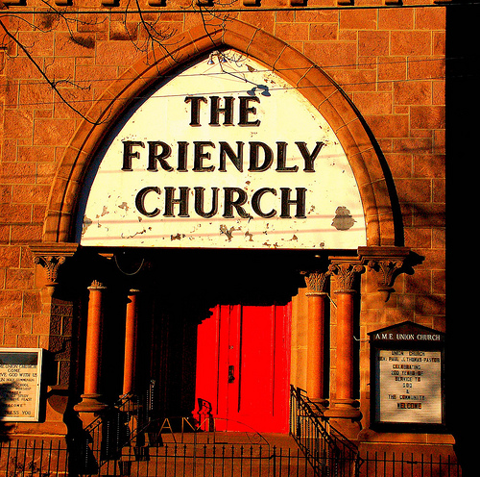
Normal expectations in church?
Trust given to authority
Culture of intimate sharing
Beloved narratives
  Redemption and restoration
  Suffering well
  Changed lives
Notes:
Image from: http://togethercanada.files.wordpress.com/2011/05/friendly-church.jpg

Slide 15
When the church hurts victims
Spiritual forms of abuse
  Prayer manipulation
  Bible used to condone victimization or silence
  Over-focus on sex and family ideals
  “Get over it” theology

Slide 16
Agents of Healing in the church
Church as Refuge

Slide 17
Leaders: Set the atmosphere
Teaching
Policy development
Training
Notes:
If virginity is so prized, does it make all victims of sexual abuse unable to be valued, cherished, and honored? No!

Slide 18
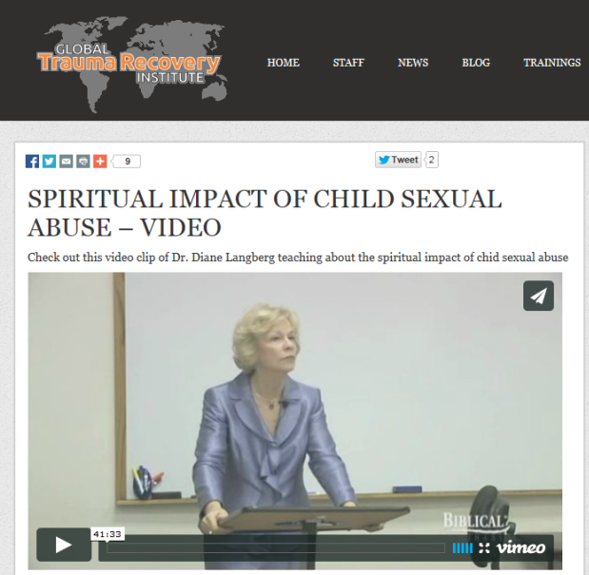
Normalize brokenness
An oppressing spiritual force
  Opposes love, the true picture of God and church
  Paints a false picture
    Abuse of power → immobilizing fear
    Deception → moral and relational confusion
    Failure to protect → chaotic choices
    Objectification → distorted view of self/bodies
    Forced false worship → Enslaved to false gods
Notes:
Teaching this can be hope building since it avoids blame, implicit or otherwise.

Slide 19
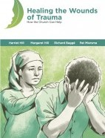
Teach and sing laments
Naming evils, oppressions, injustices, losses
Expressing sorrow and despair
Questioning God
Asking God to act
Waiting/entrusting oneself to God
Notes:
Find at bibles.com

Slide 20

Benefit of laments?
Increased communion and intimacy
  Kim Snow
Holding communion and complaint together in our “winter of faith”
R. Beck

Slide 21
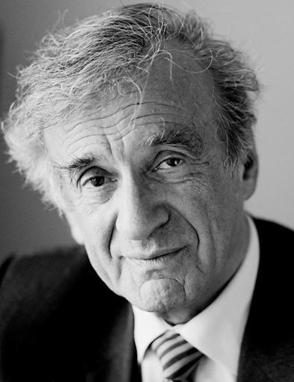

Elie Wiesel on lament
I have not lost faith in God. I have moments of anger and protest. Sometimes I’ve been closer to him for that reason.
Night
Notes:
Negative coping? Passive vs. active faith engagement? Acceptance of lament as act of faith?

Slide 22
We have a God who understands
Teach about God’s heart for the vulnerable
Teach about how God heals
Teach about how God responds to anxious people

Slide 23
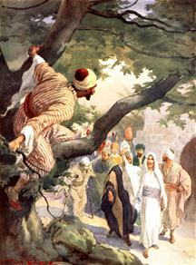
Highlight true repentance
Honest admission
Sacrificial efforts to repair
Accepts and requires discipline/accountability
Notes:
http://www.schriftstudies.tk/imghost/Zacheus.jpg

Slide 24
Develop policies
Prevention policies; train
Response policies to abuse/violence
Engagement with mental health services

Slide 25
Train up lay leaders
Develop support and care teams
  Who in your congregation are known to be good listeners? Slow to speak?

Slide 26
Not a counselor? You can help!
Listen and acknowledge
  Be a student more than a teacher
  Bear witness to losses and resiliencies

Slide 27
Listen and acknowledge
    If no one remembers a misdeed or names it publically, it remains invisible. To the outside observer, its victim is not a victim and its perpetrator is not a perpetrator; both are misperceived because the suffering of the one and the violence of the other go unseen. A double injustice occurs—the first when the original deed is done and the second when it disappears.
    Miroslav Volf, The End of Memory, p. 29

Slide 28
Listen and acknowledge
Take concerns seriously
Don’t minimize suffering and losses
Don’t talk too quickly of healing

Slide 29
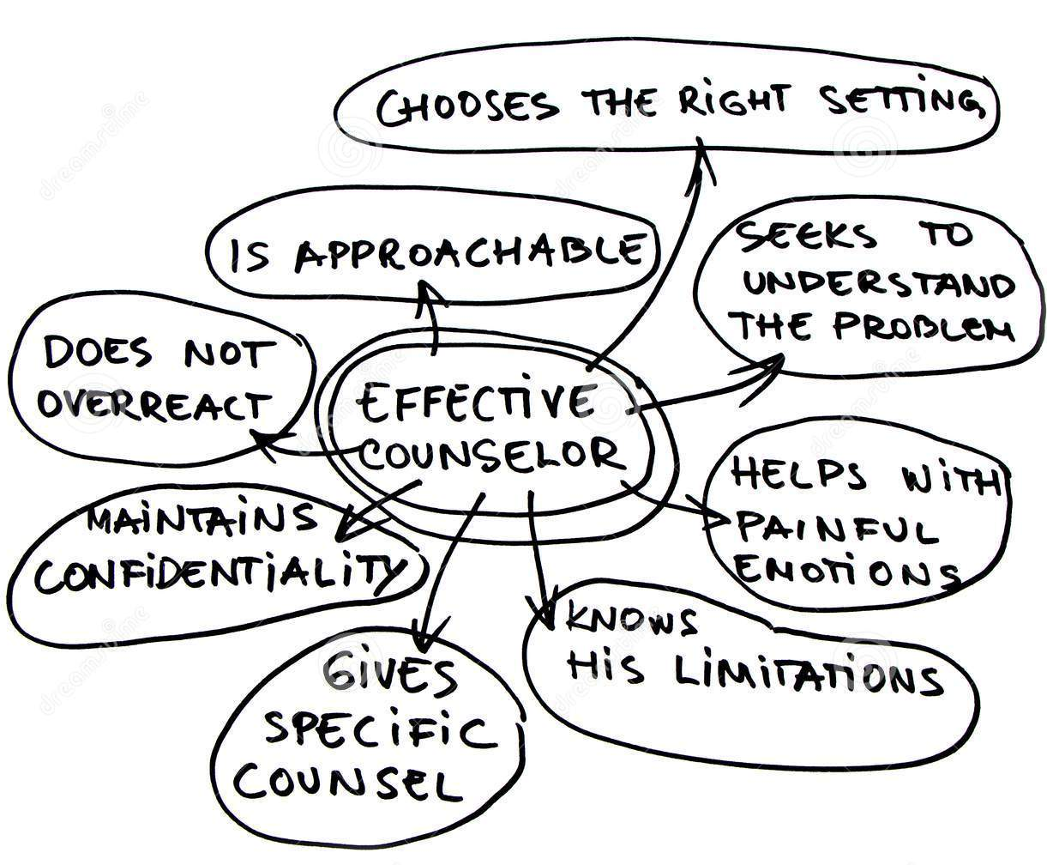
Counselor 101 skills
Don’t talk too much
Don’t push
Don’t avoid emotions
Validate
Ask open questions
Listen at 3 levels

Slide 30
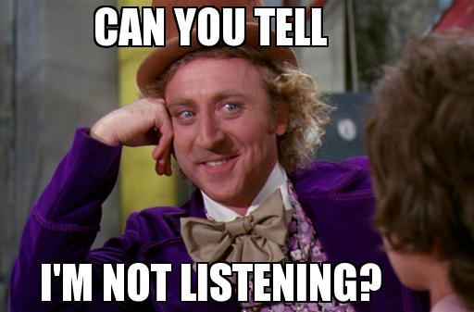
Listening means
Validating
Not looking for an explanation

Slide 31
Encourage good story telling
Tells story at own pace, no pressure
Chooses when not to tell a part of the story
Listener silence and body language to show interest
Storytelling without words
Difficult stories start and end at safe points
Good coping skills before starting story telling
Notes resiliency and strength in the midst of trauma
Story told from the present rather than reliving the story
Frequent interruptions
Forcing the story
Reliving the story
Avoiding painful emotions
Exhorting the person to get over the feelings; telling them how to feel
Only talking about the trauma, ignoring strengths and other history
Ending a session without talking about the present or a safe place

Slide 32
Pay attention to spiritual struggles
  Loss of meaning
  Spiritual struggles
  Moral injury
  Disconnection: faith and community

Slide 33
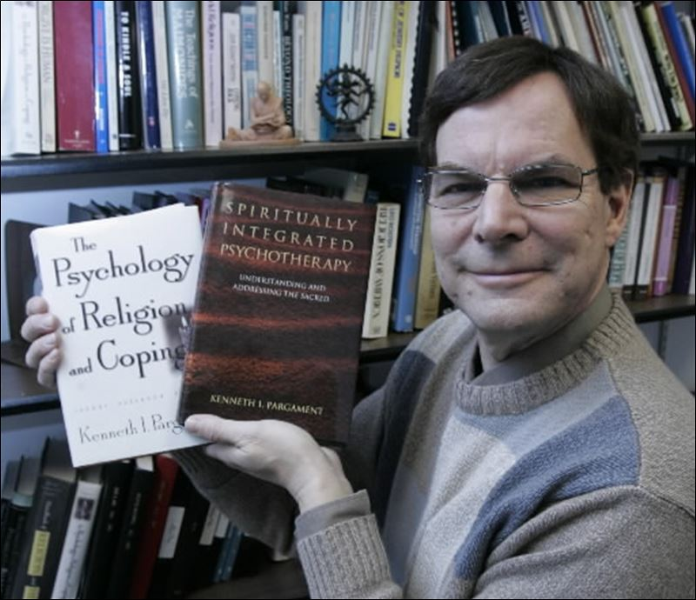
Faith and pathology?
Not all faith responses are helpful
  Desecration…rejection…angry/ominous God
  Passive spiritual responses
Notes:
See Ken Pargament’s works

Slide 34
2. When you do speak
Validate
Gentle reframes
  Ex: Noting all/nothing thinking
  Ex: Finding the good without discounting the bad
Validate (again)

Slide 35
3. Promote safety
Integrity in all things
Set and keep boundaries
Encourage voice

Slide 36
Remember!
Safe, predictable boundaries heal
Avoid all control or coercion
Speak the truth in love
Allow for brokenness
Notice incremental change

Slide 37
4. Understand their treatments
  Medications?
  Counseling models?
    Safety → memory processing → reconnection
  Counseling interventions
    Mindfulness; narrative work; Exposure → desensitization → response change

Slide 38
Understand mindfulness
Not grasping at judgments
Observing, noticing, describing, labeling
Attending to sensations; Acting with awareness

Slide 39
What might it look like?
Naming the rumination; accepting
Focusing on the present with senses
Repeating a verse
“What do you want me to be doing in the next 5 minutes?”

Slide 40

5. Recognize dangers
  Fishing for memories
  Imagery and some forms of healing prayer
  Enmeshed therapists
  Promising healing

Slide 41
Watch out: vicarious trauma
The emotional residue in your life
Evil often undermines and challenge beliefs
  Listening to stories will change you!
    …or become epitome of evil ̶ E. Wiesel

Slide 42
There IS healing!
Be present
Be watchful for day-by-day healing
Be ready to give (show) your reason for hope
But not necessarily “happily ever after”

Slide 43
2 Trajectories
Safety
Remembering
Mourning/lament
Reconnection
Hope
Silence
Forgetting
Forced reconciliation
Isolation
Fear
Notice: the goal is not the removal of “getting past, over” or removing all signs of abuse
Notes:
From Janelle Kwee in “The Adult Survivor” in Schmutzer, “The Long Journey Home, p 282f

Slide 44
Let your church be known for:
Giving scandalous grace to victims even as we give the same to offenders

Slide 45



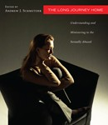
Book resources:
The Long Journey Home (Schmutzer, A. ed.)
Counseling Survivors of Sexual Abuse;
On the Threshold of Hope (Langberg)
  Group workbook now available
Rid of My Disgrace (Holcomb)

Slide 46
Web resources:
www.dianelangberg.com
www.globaltraumarecovery.org
  Free videos by Diane Langberg on abuse, trauma, and narcissistic systems and leaders
www.netgrace.org
http://cryingoutforjustice.com/contact-about-us/
  See the sermon series on domestic abuse and violence by Rev. Jeff Crippen

Slide 47
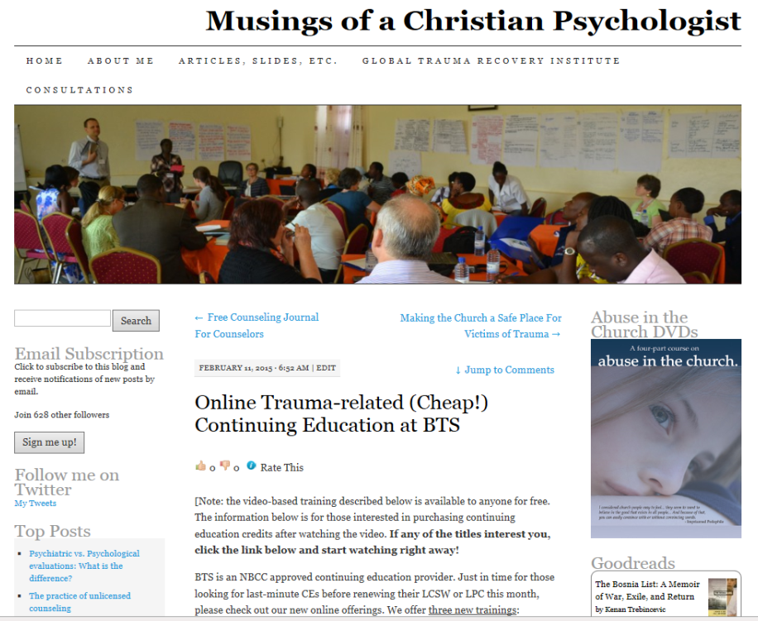
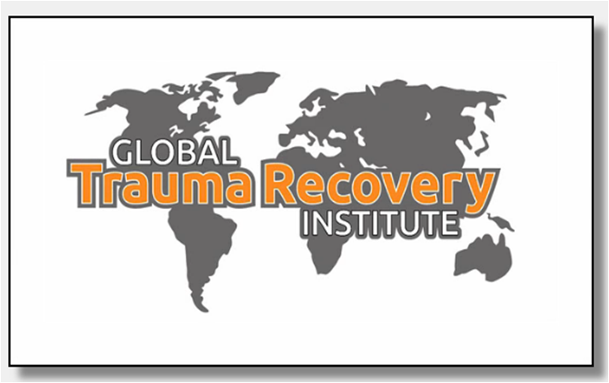

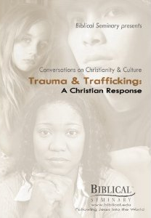

Contact: pmonroe@biblical.edu

Slide 48
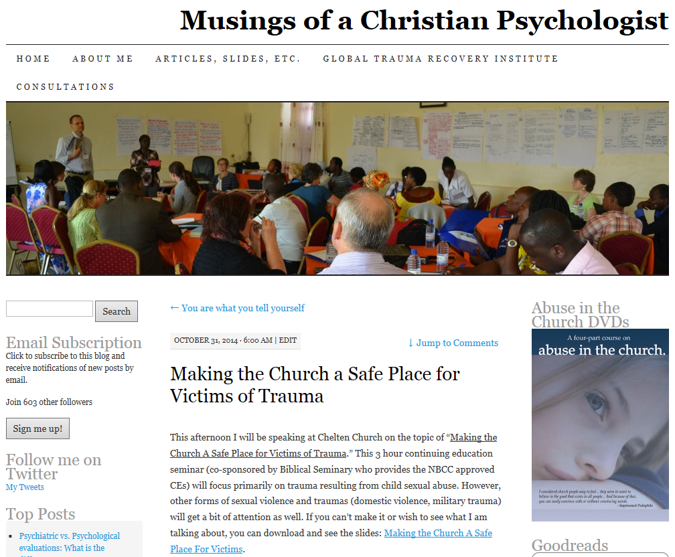
www.wisecounsel.wordpress.com
Want
More?

Slide 49
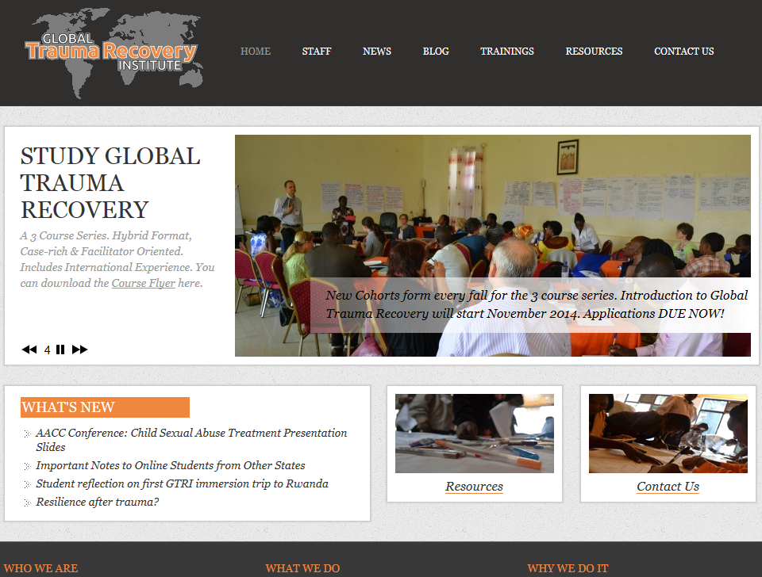
www.globaltraumarecovery.org

