Slide 1
Addressing Trauma in International Settings:
Three Models in Dialogue
AACC 2013
September 12-13, 2013
Nashville, TN

Slide 2


Slide 3
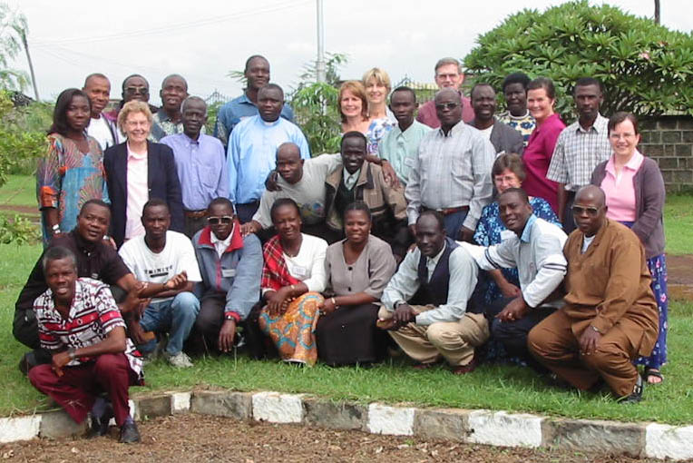
“Our people are acting strangely since the attacks:
we don’t know what to do!”
Pastors in war zones
Made in Africa
Notes:
Came into this through the missiological, Scripture Engagement door: how do you translate the Bible into the lives of people who are going through widespread, long-lasting unjust suffering? From the beginning, a marrying of Bible and mental health principles.

Slide 4
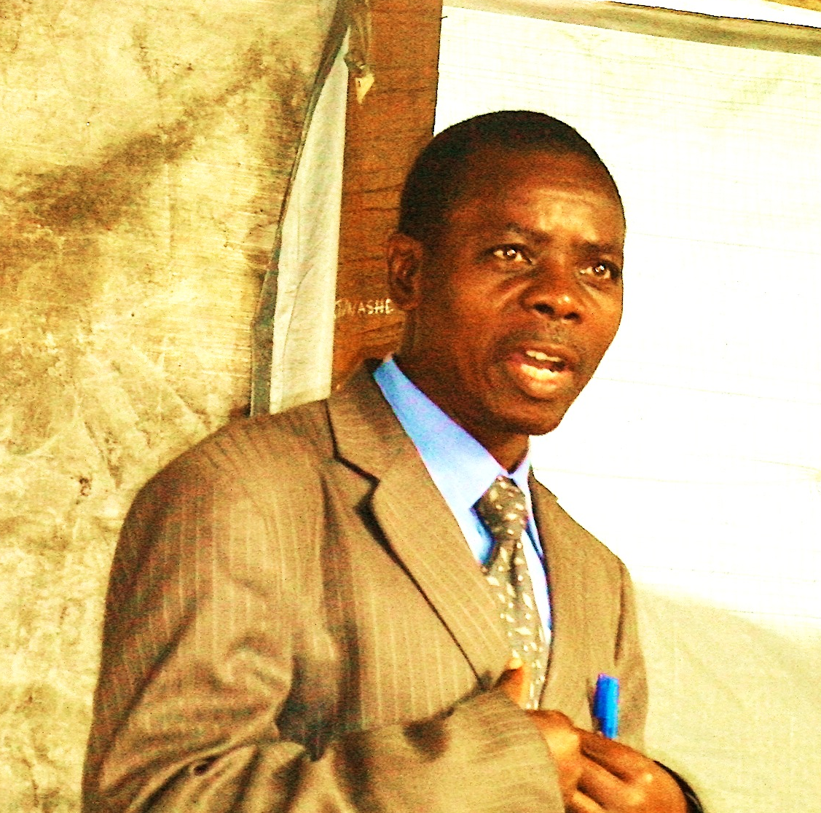
Objectives:
To help individuals and communities
Heal from emotional wounds
(Re)-engage with Scripture & God.
Be more resilient

Slide 5
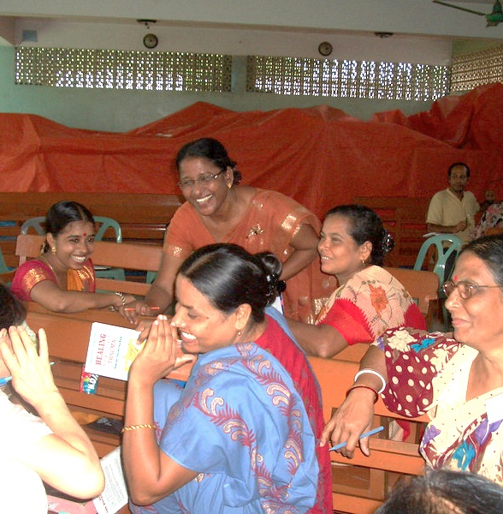
Foundational Principles
Grounded in Bible & mental health
Contextualized: translatable
Pilot-tested
Develop local
facilitators
Group-based
Sustainable

Slide 6
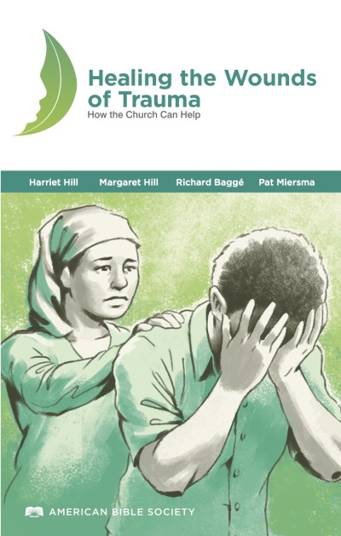
Lesson composition
Current life stories
Small & large groups
discussions
Skits, role plays, exercises
Reflection on culture
Learning to listen
Experiential: telling their story,
laments, art exercise
Bringing pain to Christ for healing

Slide 7
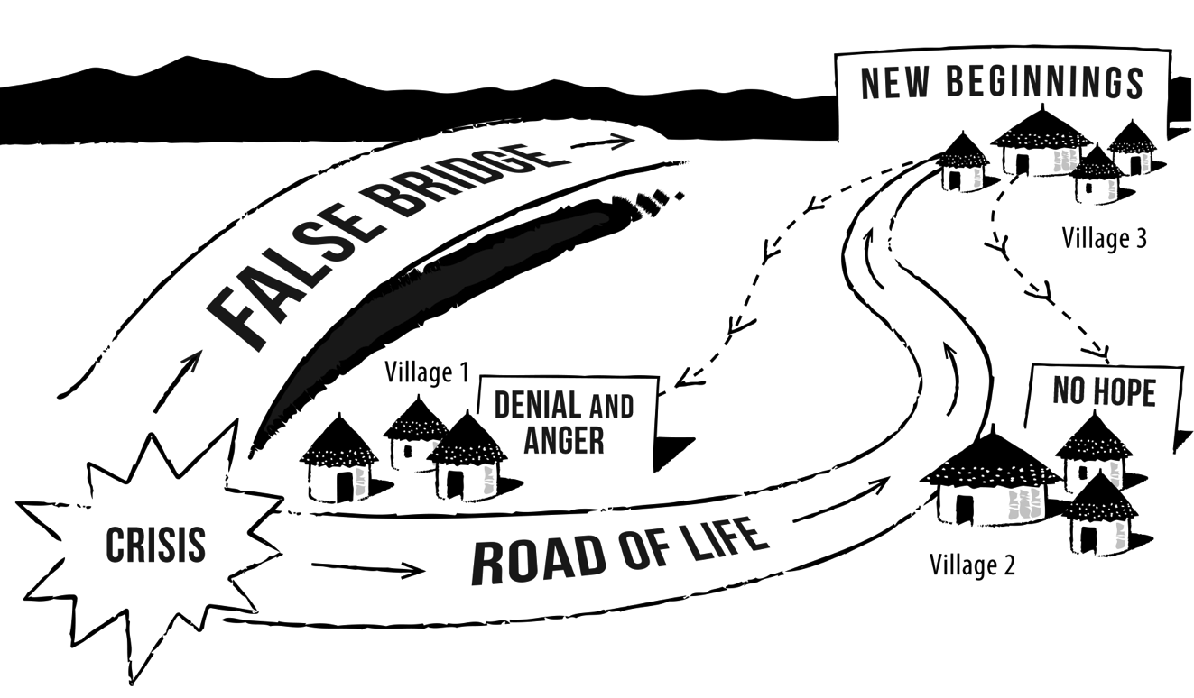
Lesson topics
If God loves us, why do we suffer?
Heart wounds
Grieving
Children
Rape
HIV & AIDS
Care for the
caregiver
Taking your pain to the cross
Forgiveness
Reconciliation
Preparing for trouble

Slide 8

Versions
For different audiences:
  Oral communicators
  Children
  Seminary courses
For different cultures:
  Latino
  Sri Lankan
  US middle class/ US marginalized
  Earthquake
Notes:
Insert kids cover

Slide 9
Four-step Program
Model
EQUIPPING
HEALING
COMMUNITY OF PRACTICE
CONVENING
Notes:
Even the care-givers are traumatized and need healing before they can minister to others.
The “Restoring” celebration signifies women’s transition from “victim” to “survivor”
This program has a multiplier effect
Audiences: Gatekeepers, Care-givers, Victims, Neighbors
Materials: Leaders kit, Equippers kit, Survivor’s kit, Bible
Healing and Restoring are local sessions.

Slide 10
Equipping Facilitators
Initial equipping session
Practicum
Advanced equipping session
Community of Practice

Slide 11
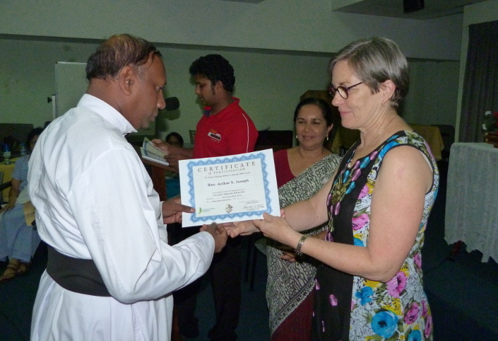
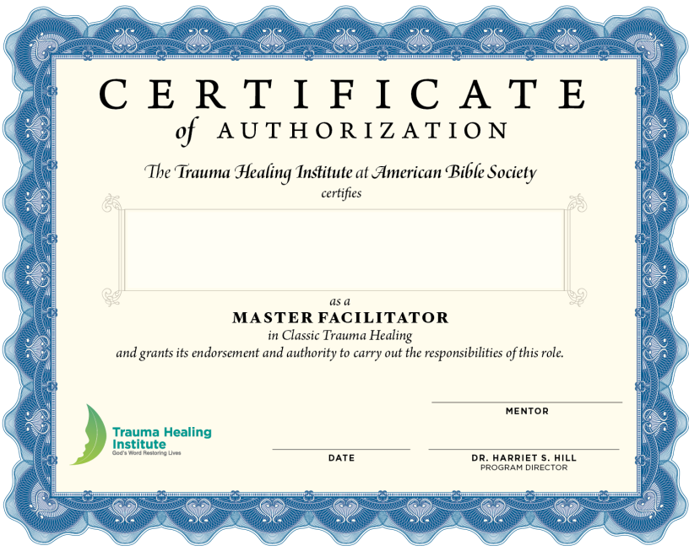
Facilitator competencies
Able to manage personal well-being.
Able to work on a team.
Understand content.
Able to help traumatized people.
Lead groups in a participatory way.

Slide 12
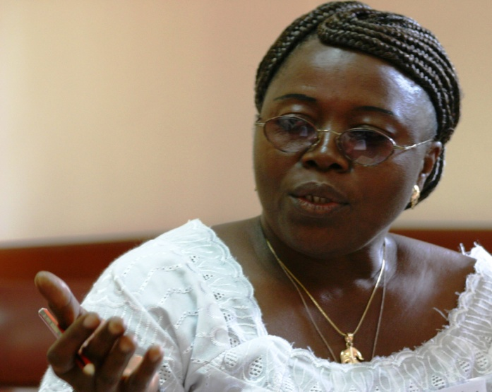
3 kinds of facilitators
Master facilitators
Trainers
Caregivers

Slide 13
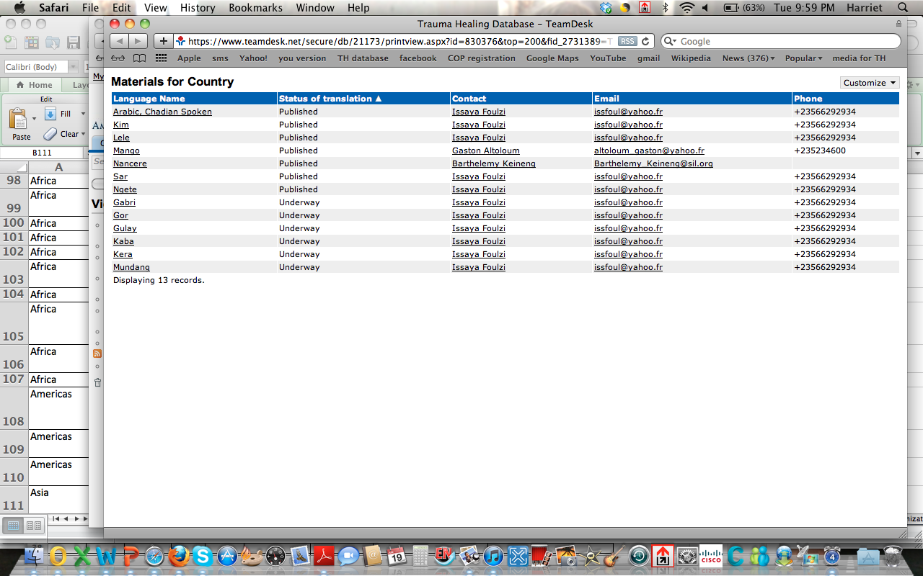
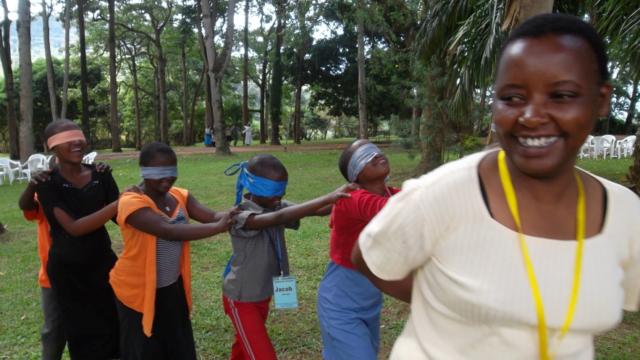
On-line database tracks:
People
Activities
Organizations
Translations
Testimonies

Slide 14
Program model
Content (contextualized)
Training
Advocacy materials
International network

Slide 15

Mental Health Grace Alliance
105 Old Hewitt Dr., Suite 100A
Waco, Texas 76712
Phone: 254.235.0616
Email: info@mhgracealliance.org

Slide 16

Hope Groups
Peer led
  4 hour facilitator training
    Lecture and experiential/role playing
Common weekly structure
  Faith, Facts, Future
Leader’s guide
CBT influenced

Slide 17
Overview
Cognitive skills development (40%)
Emotional expression and regulation (30%)
Relationship and support building (20%)
Psychoeducation (10%)

Slide 18
Topics
Week 1: Stress and Trauma
Week 2: Safety, Predictability and Control
Week 3: Rest, Relaxation and Joy
Week 4: Positive versus Negative Coping
Week 5: Depression
Week 6: Friends and Family
Week 7: Crisis and Problem Solving
Week 8: Grieving and Loss
Week 9: Guilt and Shame
Week 10: Staying Resilient
Supplemental Sessions
Rape and Sexual Assault
Combat Exposure

Slide 19
Benghazi IDP Camp

Slide 20
Benghazi IDP Camp

Slide 21
Present Use in Africa
Libya
Somalia
Ethiopia
Egypt

Slide 22
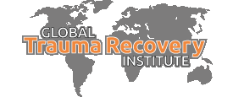
Training Competent Cross-Cultural Trainers
Goal: Raise competencies for both mental health and local leaders to support community self-care

Slide 23
Effective help?
Have a positive impact
Sustainable
Transferrable/Scalable

Slide 24
Debate:
Modify existing approach to fit a new culture?
  OR…
Start from scratch?

Slide 25
Entering a new location?
Listening Assessment
  Local view(s) of needs, strengths, opportunities, resources, desired outcomes
  Possible supporting partnerships with existing organizations, people of influence
  Extensive reading from multiple angles
  MAINTAIN AN ASSET BASED EVALUATION
Notes:
Not as linear as this looks! Requires long process of listening, clarifying, and realizing that cultural constraints will keep us from getting the whole picture. Be wary of trying to be efficient or maintaining locus of control with outsiders

Slide 26
Developing Partnerships
Find your “bridge”
Determine locus of control
Determine type of help
  Relief
  Rehab*
  Development*
Plan interventions and outcomes

Slide 27
Active Intervention
Using local leaders
Evaluate impact
Identify barriers, fill gaps
Plan exit/transition strategy

Slide 28
Example: Rwanda
2009 Listening assessment tour
2011 partnership with WorldVision and Baraka Unwingeneye
  Bring trauma recovery training to current caregivers
  Encourage local counselor support system
2013
  Additional training in related topics
  Exploring association possibilities

Slide 29
Global Trauma Recovery Institute
We provide high quality continuing educational resources, skills training, & case consultation for mental health clinicians, ministry leaders, & professionals interested in addressing the needs of psychosocial trauma victims in the United States & around the world.
www.globaltraumarecovery.org

Slide 30
Basic Competencies:
Common psychological, spiritual, physiological, and social/relational symptoms of psychosocial trauma
Lived theology of suffering and recovery via Scripture engagement to a traumatized audience
Role of culture regarding expressions of emotions, mental health, and religious practices
3 phase recovery process for individuals and communities in chronic lack of safety
Differentiate psychological first aid from recovery and rehabilitation phases of help
Notes:
What is traumatizing in culture may be nothing in another and vice versa. Must be able to hear these across cultures. For example, not being able to bury a parent was more traumatizing than gang rape by soldiers.

Slide 31
Advanced Competencies
Unique features of specific traumas
Theologies of shame and spiritual warfare
Advanced treatment options in unstable communities
Advanced cross cultural listening
Strength-based assessments
Faith engaged trauma recovery interventions

Slide 32
Training Trainer Competencies
Key facets/threats of the facilitator or “train the trainer” model
Skill in reading and communicating within and between cultures
Common group dynamics influencing caregiver learning and development
Program and process review

Slide 33
Supervised immersion

Slide 34
Contact Info
Harriet Hill/ABS
  Email: hhill@americanbible.org
  http://traumahealinginsititute.org
Matthew Stanford
  Matthew_stanford@baylor.edu
  www.mentalhealthgracealliance.org
Phil Monroe/Diane Langberg
  trauma@biblical.edu
  Info@dianelangberg.org
  www.globaltraumarecovery.org

