Slide 1
Porn Addiction? Help and Hope for You or a Loved One
Philip G. Monroe, PsyD
Biblical Seminary
pmonroe@biblical.edu

Slide 2
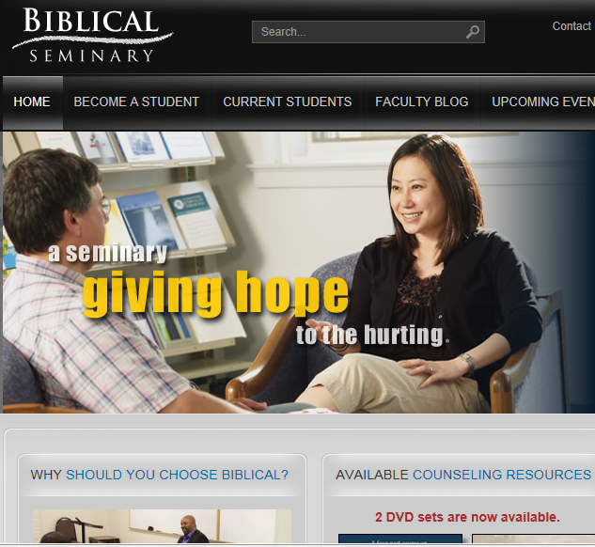
www.biblical.edu
Degrees:
MA in Counseling
MA, Ministry (Counseling Concentration)
MDiv
Urban MDiv
DMin
Certificates:
Biblical Counseling
Advanced Professional Counseling
On-line Courses

Slide 3
Topics
How porn harms
Why we get stuck
Identifying cycles and escapes
Q & A

Slide 4
Addiction? Sin?
“Never give way to reverie, imaginations or thinking over which you have no control; to do so is the surest way to slip into a relapse.
Few of us realize the power God has given us to grip on the threshold of the mind as in a vice the things that ought not to be there.”
Oswald Chambers: Notes on Jeremiah, p. 1396 (Jer. 4:14)

Slide 5
How Porn Harms
Your brain can’t tell the difference between “real” sex and porn
It harms relationships with others
It deadens your faith

Slide 6
Why We Get Stuck
The process of getting stuck
Seeking the wrong goal

Slide 7
The Process
Addiction is a body, spirit, and will problem
  Sin is both chosen and irresistible
We are made to desire God and creation. But since sin enters the world,
  We long for things that are out of reach
  These unfulfilled longings are painful
  We often turn good desires into demands
  We desire too little rather than too much
  We choose behavior management rather than transformation

Slide 8
Sex: A Powerful Desire
Why is Song of Solomon in the bible?
  Why detail the erotic longings of a couple?
  Notice two emphases
    Sex is a most powerful desire—and good
    Sex is something not to be awakened before its time

Slide 9
The Descent of Desire
Foolishness
Friendship
Sin
Infatuation
Bondage
Betrayal
Tragedy
Worship
Adapted from Addictions: A banquet in the grave (E. Welch)

Slide 10

Habits
BONDAGE!
Self-Deception
False Worship

Slide 11
Waking Up Dead?
Ezekiel 23
  Two young virgin women have become prostitutes and used
    One is given over to destruction, the other sees but does not seem to care
  “…So you longed for the lewdness of your youth, when in Egypt your bosom was caressed and your young breasts fondled.”

Slide 12
How Addictions Start
It starts with me! (Hint, it is not really about the sex!)
  What makes me feel special? What fulfills me? What stops the pain?
Sex becomes the means to get what I want
  Indulgence → out of control behavior → failed efforts to limit or stop → increasing obsessions → mood changes → neglect of important things → self-loathing/suicidal thinking

Slide 13
2 Types of Addictions
Escapist
  Tends to be Internet, video or object based (may avoid actual sexual contact with others) with masturbation
Relational
  Anonymous encounters, multiple partners, voyeurism, exhibitionism, pedophilia, power encounters

Slide 14
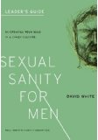
The Wrong Goal
Wanting Jesus to be your substitute for porn!
David White: Sexual Sanity for Men

Slide 15
The Cycle of Addiction
1. Common cycle of abstinence to addiction
2. Learning the cycle of addiction helps to see
a. temptations, vulnerabilities, and
b. ways of escape

Slide 16
The Cycle of Addiction
Abstinence
“Never again”
Penance
Trigger(s)
Guilt
Tempting Thoughts
Defeated Interpretations
SUDS
Indulge
“I can handle it”
Adapted from Patrick Carnes

Slide 17
Escapes: The Path to Freedom
Breaking the cycle
Uncovering deception, seeking light
Understanding the root issues
Recovering Godly desire
Restoring broken relationships

Slide 18
1. Breaking the Cycle of Addiction
Abstinence
“Never again”
Penance
Trigger(s)
Guilt
Tempting Thoughts
Defeated Interpretations
SUDS
Indulge
“I can handle it”

Slide 19
2 & 3. Uncovering Deceptions And Root Issues
Deceptions
  All sin starts with self and other deception
  Most addicts are aware of the “big” deceptions but fail to recognize the “little” ones that happen daily
  Recovery is like waking up from a coma
Root issues
  Must haves? Needs? Desires? Practiced habits?

Slide 20
Some Questions For You
What motivates me to get better or to seek help?
Am I ambivalent about change?
How truthful have I been since discovered?
Do I accept intrusions into my privacy?
Do I demand others trust me?
What is my record for saying no to temptation?
What other problems need to be addressed?
Do I see the roots of my sexual behavior?
What human resources are available to me?

Slide 21
4. Recovery of Godly Desire
Delight in the fear of the Lord
Doing violence against addictions: A response to God’s grace
Engage the battle at the level of imagination
Speak honestly, uncover subtle lies
Surround yourselves with wise counselors
Remember God’s commitment to you
Engage in the battle against distorted affections
Adapted from Addictions: A banquet in the grave (E. Welch)

Slide 22
Habits
BONDAGE!
Self-Deception
False Worship

Slide 23
Breaking Self-Deception
Fight for truth! (Self-deception is the gateway sin)
Challenge! Having thoughts of self other than we want to have
Identity as lost sheep
Recognition of vulnerability to “finding” ourselves
Habits
BONDAGE
Self-Deception
False Worship

Slide 24
Proper Worship
Practicing proper meditations
Meditating on 1 thing
Looking beyond self to God/other
Example: What do you think about when you wake up in the night?
Habits
BONDAGE
Self-Deception
False Worship

Slide 25
Habit Change
Protecting good habits; building new
Doing violence to bad habits
Using all the means of grace/mercy (spiritual, biological, communal, economical, etc.)
Habits
BONDAGE
Self-Deception
False Worship

Slide 26
5. Restoring Relationships
Honest admission (forever!)
Sacrificial efforts to repair (Check out Zaccheus in Luke 19)
Acceptance (with joy) discipline and limits
No demands to be trusted but desire to “restore the years the locusts have taken” via listening

Slide 27
Practical First Steps
Make no long term decisions
Short-term decisions should focus on protection/safety for all
Assess scope of the problem
  Frequency, duration, intensity
  Response of addict? Family?
  Resources available; commitment to help-seeking?

Slide 28
External Helps
Electronic accountability (tracker/filter)
  Covenant Eyes? Bsafe? XXXChurch
On-line care?
  www.purelifeministries.org
Support groups?
  HarvestUSA (www.harvestusa.org)
Psychiatric and counseling helps?
Inpatient?

Slide 29
Counseling?
Deal with shame, encourage hope despite ashes
Explore roots, shoots, fruits of addiction (cycle)
    Denial, self-deception, impulsivity, complacency?
    Self-talk?
Validate desires and seek to deal with them in godly manner
  Offer accountability and practical ideas
  Point out victory!

Slide 30
If You are the Helper?
Set the stage for work together
  Validate, explore, build trust, provide safety
  Balance teaching, exploration, and honest responses
Uncover denial/deception and recognition of divided loyalties (in love)
  Offer accountability
  Focus on commitment strategies
Watch your own life!

Slide 31
Finally…
Don’t forget that God is doing a work in both addict and loved one!
  That ALL sin separates us from God
  That helper and addict both need GRACE
  That the Christian life is an opportunity to
    Address heart issues, uncover denial, and complacency
    See God’s hand in a broken world

Slide 32
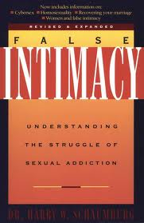

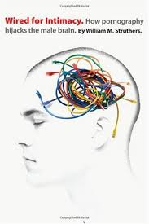
Harry Schaumburg William Struthers

Slide 33
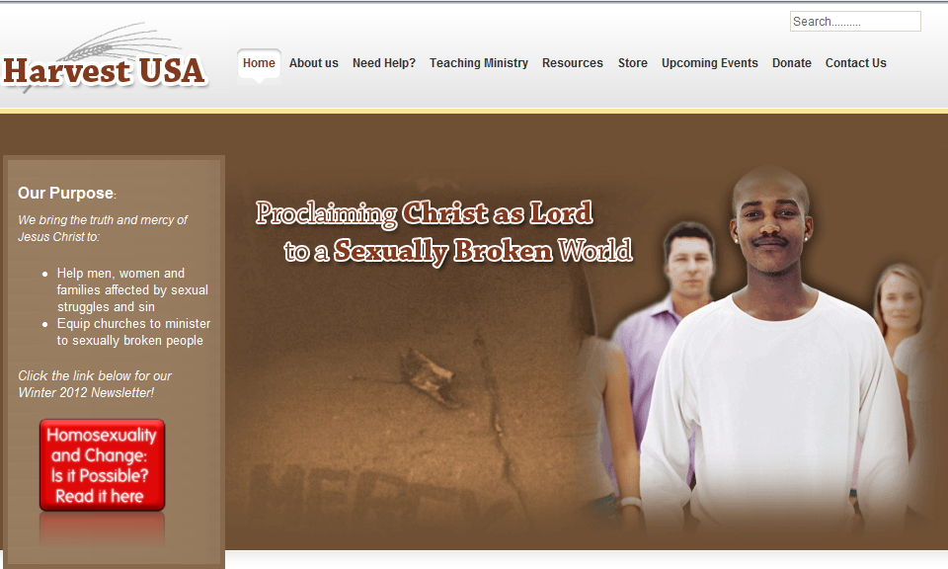
Local: www.harvestusa.org

Slide 34
Questions?
www.wisecounsel.wordpress.com

