Slide 1

Abuse In The Church:
Biblical, Legal, & Counseling Perspectives
When Good People Do Nothing:
Why We Fail To Respond Well to Abuse
And What We Can Do About It
Philip G. Monroe, PsyD
Biblical Seminary
pmonroe@biblical.edu

Slide 2
Which Hurts More?
Wounds from an enemy?
or…
Neglect from a friend?

Slide 3
We Never Do “Nothing”
  "It is very tempting to take the side of the perpetrator. All the perpetrator asks is that the bystander do nothing. He appeals to the universal desire to see, hear and speak no evil. The victim, on the contrary, asks the bystander to share the burden of pain. The victim demands action, engagement, and remembering.”
  Judith Hermann, Trauma & Recovery, p. 7

Slide 4
Session Goals:
Reasons we don’t act as we should?
  Individual
  Corporate
What will help us rectify this problem?
  6 proactive actions

Slide 5
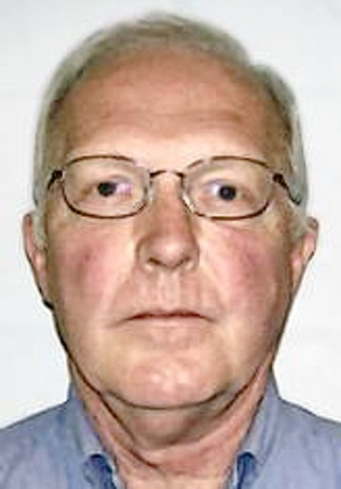

Individual Reasons:
Winsomeness of abusive person
Denial
Doubt: self and victim
Self-protection

Slide 6
Group Reasons:
Mistaken beliefs
Groupthink
System protection
Cultural constraints
Notes:
Ian Richardson (actor) in House of Cards, “When you will the end, you will the means.”

Slide 7
6 Proactive Actions
Educate the whole church
  Start with Scripture
    True Religion: James 1:27
    Mandate to submit to governments: Ro 13; 1 Pet 2
  Note: more than just to avoid the millstone!

Slide 8
Educating the Church: 4 key areas
Develop a theology of oppression to explain impact of trauma
  5 facets of oppression (the opposite of love)
    Abuse of power
    Deception and false teaching
    Failure to lead
    Objectification
    Forced false worship
  Failure to love violates the imago dei and the Trinty?
From “The nature of Evil in CSA: Theological considerations of oppression and its consequences” in Schmutzer, A (ed.) The Long Journey Home: Wipf & Stock.

Slide 9
Communal Imago dei?
Human beings reflect the character and essence of God most fully when they relate to each other as fellow members of a covenant community—one founded on unity, diversity, and sacrificial love.

Slide 10
Distorted Imago dei?
So…
If personal identity forms through interwoven relationships with other members and with God—a reflection of the perfect communion within and between the members of the Godhead—then evil done by one community member against another violates the true picture of communion as expressed in the Trinity.
Monroe, in Schmutzer (ed.), The Long Journey Home (ch. 13)

Slide 11
Educating the Church: 4 key areas
Acknowledge lasting impact on individuals
  Relational anxiety
  Physiological alterations
  Spiritual confusion
Identify community helps:
  Safe, hope-filled, boundaried relationships that enable
    Victim to be heard
    To have dominion
Notes:
What if abuse victims appear to refuse good advice
Sinful anxiety? Rebellious? Refusing to forgive?

Slide 12
Educating the Church: 4 key areas
Develop a larger view of healing
  What constitutes healing?
  How do we participate in God’s healing?
    Support? Mercy? Prayer? Listen? Play?
  Remember: some healing is immediate, other healing grows day by day

Slide 13
Educating the Church: 4 key areas
Explore ancillary themes: forgiveness, reconciliation, restoration, restitution, etc.
  What is the rush?
    Why forgiveness now?
    Point in time? Attitude?
    Why reconciliation now? What bothers us most about brokenness?
  What does repentance look like?
    What about restitution?

Slide 14
6 Proactive Actions
Plan ahead!
  Safety policies; background checks for ALL
  Reporting policies
    Train!
Notes:
What sports team develops plays but never tries them until gameday?

Slide 15
6 Proactive Actions
Network
  Get to know your local law enforcement, child protection advocates, prosecutors, counselors
    Treat them as teachers and supporters, not enemies!
  Learn from other Christian groups

Slide 16
6 Proactive Actions
Expand ministry of spiritual care
  Ministry to victims, victims of other abuses, offenders, family members, congregation and community
    Recognize ministry limitations and collaborate with other trained professionals
    Avoid the temptation to keep it all “in-house” by getting outside consultation
    Remember to care for leaders!
Notes:
More on this in my next plenary

Slide 17
6 Proactive Actions
Respond well to abuse by leaders
  Refuse all cover-ups, white-washes, letting leaders “leave with their reputations”
  Correct/repent for prior mistakes
  Choose truth as an adornment over reputation

Slide 18
6 Proactive Actions
Consider your own propensity for sin
  Choose to live in the light with fellow sinners

Slide 19
Network
Plan and Train
Educate
Repent
Rectify
Ministry

Slide 20
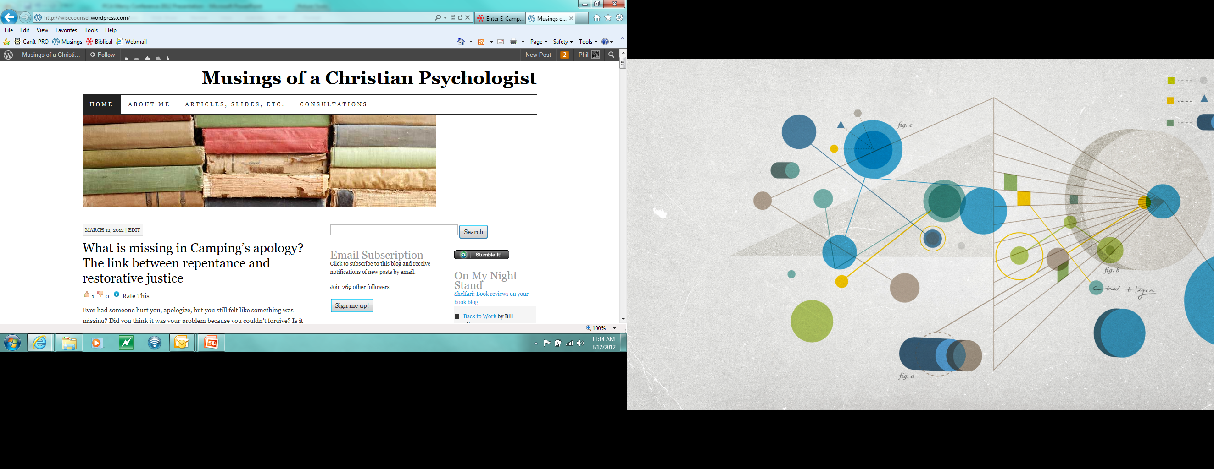
www.wisecounsel.wordpress.com

Slide 21
Guiding Responses to Abuse in the Church
Best Restorative Practices
Philip G. Monroe, PsyD
Biblical Seminary
pmonroe@biblical.edu

Slide 22
2 case studies
Church A
  Pastor involved in sexual activity with someone he is counseling
    Parishioner is known to be demanding and coy
    Pastor has had a good reputation
Church B
  Lay leader caught in an sex sting, spends 1 year in federal prison
    Released, wants to return to church next week

Slide 23
A tale of 2 committees
Committee One
  Figure out what to do next? How to respond?
Committee Two
  Decide desired outcomes and supporting values

Slide 24
Key struggles:
Who are the stakeholders?
  What are their common reactions?
Desired outcomes?
Likely landmines?

Slide 25
Caring for offenders AND victims?
Is possible!
  Requires planning and preparation before a crisis
Requires key shaping values
  Protection for all
  Mercy for both offender and victims
  Love and truth as acts of worship
  Engagement with community wide resources
  Willingness to take the long approach to care

Slide 26
Session goals:
Quick review of ministry challenges
Boy Scout ready for mercy ministry?
  Values
  Education
  Policy
Spiritual care teams (SCT) approach
  Special focus on your activity in guiding SCTs

Slide 27
Reasons we fail to act?
Self-protection
System protection
Groupthink
Denial and self-doubt
Perceptions of victim/abuser

Slide 28
Common church reactions
Failure to report abuse of minors
  Attempts to discover truth on own
Cover-up for the sake of reputation
Half-truths; silence
Blaming the victim
  Pastoral sexual abuse or affair?

Slide 29
Additional reactions
Ignoring congregation and other victims
Focus on getting beyond the abuse
  Normalcy over ministry
Treating abuse as an isolated incident
  Ignoring systemic issues; ignoring the opportunity

Slide 30
Network
Plan and Train
Educate
Repent
Rectify
Ministry

Slide 31
Preparing for mercy ministry
Education
Abuse/impact
Abusers
Policy
Allegations
Prevention
Ministry
Victim/family
Offender/family
Community
Assessment

Slide 32
Planning for abuse crises
Define: values/goals
Educate: understand abuse and its impact
Build: policy and ministry teams
Assess: needs/fruit
Develop: mercy ministry trajectories for
  Victims (and their families)
  Offenders (and their families)
  The congregation

Slide 33
Define: values/goals
What do you want to undergird your work?
  Protection of the least of these (victim/offender)
  Mercy Ministry focus (vs. outcome)
    What would be considered a mercy?

Slide 34
Additional values?
Love and truth?
Purity?
Redemption?
Healing? Restoration? (To what?)
Engagement with non-church experts?
Fairness?
  Is there a danger to this?

Slide 35
Preparing for mercy ministry
Education
Abuse/impact
Offenders
Policy
Allegations
Prevention
Ministry
Victim/family
Offender/family
Community
Assessment

Slide 36
Educate:
Abuse
  Forms, impact, common reactions
Abusers/Offenders
  Common habits? Common responses?
  Deception and its impact on self/other
  Common family/spouse responses?
Abuse related laws/regulations
  Agencies and resources

Slide 37



Three important books
Langberg, D. On the Threshold of Hope
Salter, A. Predators: Pedophiles, rapists, and…
Schmutzer, A. The Long Journey Home

Slide 38
Don’t reinvent ministry wheels
Learn from other churches
  Ministry to victims
  Ministry to offenders
Learn from child protection experts

Slide 39
Preparing for mercy ministry
Education
Abuse/impact
Abusers
Policy
Allegations
Prevention
Ministry
Victim/family
Offender/family
Community
Assessment

Slide 40
Policy
Who is in charge? Who manages details? Who knows the details?
What will happen once abuse is known?
  Reporting? Assessing? Communications? Ministry supervision?
  Special case for leader abuse?
  Do not make decisions in large-group settings!

Slide 41
Abuse Allegation
Gather Data
Set Guiding Goals
Congregational
Communications
Employment Decisions
= Report if appropriate
Terminate
Suspend
= offer spiritual support
Sample procedure for clergy sexual abuse case

Slide 42
Key assessments
Victims
  Spiritual needs of victims and family members
  Ongoing legal/civil stressors
Offenders
  Ongoing legal/civil/employment stressors
  Motivations of offender/family; Stated goals?
  Transparency? Caught? Confessed?

Slide 43
Preparing for mercy ministry
Education
Abuse/impact
Abusers
Policy
Allegations
Prevention
Ministry
Victim/family
Offender/family
Community
Assessment

Slide 44
Victim related interventions
Stabilize
  Address safety matters
  Prioritize the victim’s connection to worship
  Determine leadership oversight (don’t forget gender issues)
  Speak to attempts to lay partial blame on victim
Support
  Form small group of “listeners” who can support victim’s voice and therapy

Slide 45
Offender related interventions
Commitment focus
  Focus on big picture motivations and main truths
  Encourage action while pressure is on
  Validate small signs of repentance
Support
  Provide ongoing safe place for spiritual care for offender and family

Slide 46
Intervention Planning
Determine key constituents to help
Choose & train SCTs
Use of outside consultants for groups or members
Develop SCT goals & objectives
SCT time together
SCT time with key others
Sample procedure for spiritual care teams

Slide 47
Spiritual care team approach
Small group designed to pastor
  Contains both sexes
  Wise, not necessarily professional
Supported by leadership and outside resources
Place for worship, self-evaluation, encouragement, and growth

Slide 48
The purpose of the SCT is…
Support and assistance [for] acute spiritual needs
Receive comfort, opportunity to dig deeply and repent deeply, and grow spiritually (there may be other roots, but team will explore spiritual roots)
To bring hope to those who are broken, disillusioned, and in need of restoration
From Wilson et al, Restoring the Fallen

Slide 49
The purpose of the SCT is…
Penetrate denial and clarify reality
Intercession and combined wisdom
Guidance, accountability, and direction
to Encourage the whole community
  To avoid the tendency to either throw out or ignore the sinner or the victim

Slide 50
Prepare the SCTs
Spiritual work means warfare: Worship!
Group learning (biblical and experiential)
  Abuse, abuse of power, deception/denial, their impact on others, protection, true and false repentance, restoration, restitution, forgiveness, healing, etc.
  Restoration processes (time, process, fruit?)

Slide 51
Group training
Group functioning needs practice!
  With and without ministry target
    Who leads, who confronts?
    How are decisions made?
    Who communicates with outsiders?
Common areas of weakness?
  Validation; good questions; listening for what is missing

Slide 52
SCT trajectory for restoration
Protection from self and others; boundaries set
Truth-telling about the abuse
Submission to process and acceptance of spiritual mentors
Discovery of roots of abuse and other sin (naming things from God’s view; hearing from others)
Notes:
Modifiable for victim’s needs too

Slide 53
SCT trajectory for restoration
Deeper Truth-telling about life patterns and God’s sanctifying work
Restitution (acknowledges injustice and seeks to correct it)
Repentance (from actions and attitudes)
Reconnection to the larger body of Christ
Notes:
Modifiable for victim’s needs too

Slide 54
Don’t forget about the Church!
Common message in sin revelations in the church?
  Pray for brother _______. Don’t talk about it.
Assume there may be
  Hurts in the church body
  Confusion
  Others who need to repent

Slide 55
Address key topics
How does God meet us in our times of trouble?
What does it mean to love? To forgive? To hold accountable?
What is grace?
What is healing in a broken world?

Slide 56
Prepare for pitfalls!
False or partial repentance
Blaming/defensiveness
Pressure for mechanical restoration
Calls for fairness
Power struggles
Devaluing the grace of restriction

Slide 57
A word to the guides
Watch out for
  Loneliness
  Bitterness
Remember who and why you serve
Remember your own need for holiness
  Restore gently…repent boldly

Slide 58
A vision for the church?
^{PHP 3:12} I want to know Christ and the power of his resurrection and the fellowship of sharing in his sufferings, becoming like him in his death, and so, somehow, to attain to the resurrection from the dead.
^{ISA 61:1} The Spirit of the Sovereign LORD is on me, because the LORD has anointed me to preach good news to the poor. He has sent me to bind up the brokenhearted, to proclaim freedom for the captives and release from darkness for the prisoners, to proclaim the year of the LORD's favor and the day of vengeance of our God, to comfort all who mourn, and provide for those who grieve in Zion--to bestow on them a crown of beauty instead of ashes, the oil of gladness instead of mourning, and a garment of praise instead of a spirit of despair.

Slide 59
www.wisecounsel.wordpress.com

Slide 60
Helpful websites
http://www.netgrace.org. G.R.A.C.E (Godly Response to Abuse in the Christian Environment).
http://www.peaceandsafety.com. PASCH (Peace and Safety in the Christian Home)

Slide 61
Helpful articles & chapters
Langberg, D. (1996). Clergy sexual abuse. In Kroeger & Beck (eds) Women, abuse, and the Bible. Grand Rapids, MI: Baker Books.
Maxwell, J. (2006). Devastated by an affair: How churches heal after the pastor commits adultery. ChristianityToday. http://www.ctlibrary.com/39606.
Monroe, P. (2006). Abusers & true repentance. Christian Counseling Today, 13:3, 48-49.
Reed, E. (Winter, 2006). Restoring fallen pastors. Leadership Magazine. Found at: http://www.ctlibrary.com/le/2006/winter/22.21.html

Slide 62
Helpful books
Armstrong, J.H. (1995). Can fallen pastors be restored? Chicago, IL: Moody Press.
Grenz, S. & Bell, R. (1995). Betrayal of trust: Sexual misconduct in the pastorate. Downers Grove: IVP.
Hoge, D.R., & Wenger, J.E. (2005). Pastors in transition: Why clergy leave local church ministry. Grand Rapids, MI: Wm. B. Eerdmans Publishing Co.
Hopkins, N. M. (1998). The congregational response to clergy betrayals of trust. Collegeville, MN: The Liturgical Press.
Hopkins, N. M. & Laaser, M. (1995). Restoring the soul of a church: Healing congregations wounded by clergy sexual misconduct. Collegeville, MN: The Liturgical Press.
Langberg, D. (2003). Counseling survivors of sexual abuse. Xulon Press.
Langberg, D. (1999). On the threshold of hope: Opening the door to healing for survivors of sexual abuse. Carol Stream, IL: Tyndale House.
Pedigo, T.L. (2004). Restoration manual: A workbook for restoring fallen ministers and religious leaders. Colorado Springs: Winning Edge Ministries.
Schmutzer, A. (ed.) (2011). Long journey home: Understanding and ministering to the sexually abused. Wipf & Stock.
Wilson, E. & S., Friesen, P & V, Paulson, L & N. (1997). Restoring the fallen: A team approach to caring, confronting, & reconciling. Downers Grove, IL: IVP.
Yantzi, M. (1998). Sexual offending and restoration. Scottsdale, PA: Herald Press.

Slide 63
Essentials for Counseling Offenders
Strategies & Goals
Philip G. Monroe, PsyD
Biblical Seminary
pmonroe@biblical.edu

Slide 64
Can you predict who will re-offend?
No! (this is why “stranger danger” fails!)
  Histories are better than judgment
Danger signs
  Avoids mature peer relationships, accountability
    Egocentric relationship style
  Gives sacrificially but self-promotional about it
    Cloud of suspicion but continues to put self in “risk” positions

Slide 65
Session goals
Guidelines for counseling and care
  4 Dos
  4 Don’ts
Restorative Justice?
Q & A

Slide 66
Do: treat offender as imager of God
Your relationship should not be a barrier
  Full of mercy and grace
  As such were some of you!
Avoid an adversarial approach
  Even when they are lying to your face!
Validate emotions and experience
  Make commitment to process the MAIN topic

Slide 67
Don’t: treat everyone the same
Not all clients are the same
  Predatory individuals need expert care
  Get supervision; consider referrals
Not all who abuse are the same
  Abuse/manipulation of adults vs. child sexual abuse

Slide 68
Two different offenders
Child Sex Offender
  Reported?
  Convicted?
  Incarcerated?
  Paroled?
  Treated?
Key Issue: Where can I live, work, worship? Did prison provide real treatment?
Leader sex abuser
  Victims are adults
  Not reported; not public (at first)
  Not engaged with outside agencies
Key Issue: Who has to know? Will I return to ministry? Repentant?
Notes:
Safety with leader/clergy sexual abuse is not physical but emotional.

Slide 69
Do: Recognize patterns of response
Caught
Denial
Defense
Blame
Explanation
Sorrow
Re-interpretation
Hurt

Slide 70
Early Counseling response patterns
Generalized confession
Focus on losses
Focus on “forgiven”
Anger at restrictions
Seeking validation

Slide 71
Don’t: Ignore histories or roots
Example: How does a leader groom and abuse another adult
  See self as weak and needy
  Practice guilt assuaging narrative
    Denial
    False repentance
  Avoid big ticket sins while excusing “smaller” ones
  View others as extension of self
  See key counseling goals in this pattern?

Slide 72
Do: Assess…
Readiness for help (caught or confessed?)
  Barriers to remove; encouragers
  Denial and deception levels
Safety and protection needs
Insight; emotional and relational capacities
Personality
Histories (family, social, sexual, etc.)
Community support
  Personal and professional

Slide 73
Don’t: Use unreliable measures
Unreliable assessment of progress:
  Time in counseling; unsubstantiated truth-telling; tears; words
  Instead, listen for truth “between the lines”
Watch out for financial and family pressures
Remember: some broken things in this world are not made right until heaven
  Avoid the rush to restore, reunify, reconnect

Slide 74
Do: Set specific goals
Respond to victim(s) with empathy
  Apologize deeply without “but”
Living with limits without resistance
  Attend to guilt and grace
Identify everyday narratives that might support and allow mis-use of others
Explore anger and other emotional experiences
Expand view of God, cross, and self

Slide 75
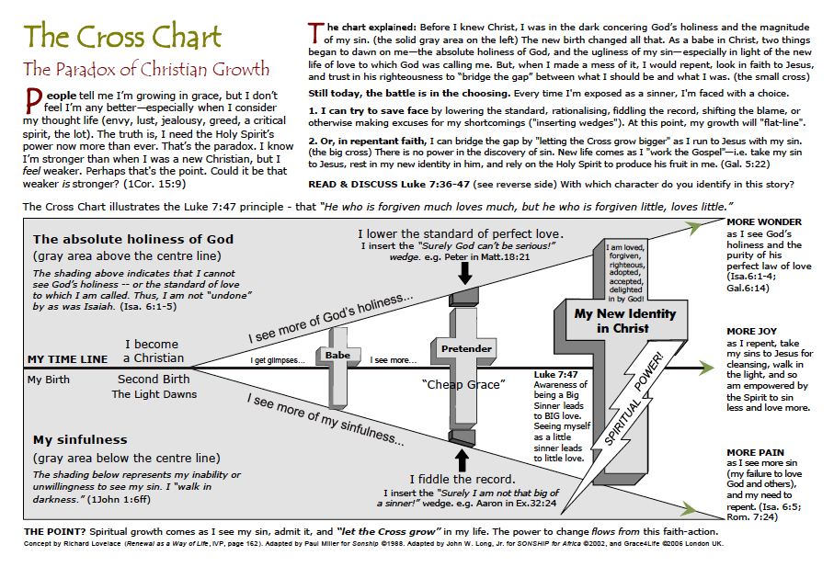
Notes:
Paul Miller’s version of Richard Lovelace illustration. Promoted by WHM’s Sonship.

Slide 76
Sample
Invitation to responsibility taking
  To submit to a ban
  To examine one’s cycle of abusive behavior
  To examine faulty reasoning
  To acknowledge own woundedness
  To acknowledge abuse with guilt-based apology
    Vs. shame, fear, pseudo apologies
  To hear the voice of the abused
Kelvin Mutter, “Confronting Abuse” in Schmutzer (Ed.) The Long Journey Home, pp. 262-276

Slide 77
Don’t: Be caught off-guard…
…by Solomonic questions
Why can’t I worship in church?
  Am I a leper?
  Why do I need a shadow?
Why does [victim] get to call all the shots?
Doesn’t [adult victim] bear responsibility too?
Isn’t it better to go somewhere new where we can worship in peace without prying eyes?
Doesn’t [victim] have to forgive me?
  [victim] forgave me, why am I still being restricted?
Isn’t [offender] repentant?

Slide 78
Repentance
Signs of the real thing and imposters

Slide 79
Are those tears real?
What tells you that someone is repentant?
  Attitude?
  Accountability?
  Attention?
  Action?

Slide 80
The real test of repentance?
TIME and ______

Slide 81
Questions to ask yourself?
How do they respond to when others bring up their offenses?
How do they respond to accountability?
  Passivity is not always acceptance
  Do they chafe against the grace of restriction?
Are they growing in awareness of their impact? Of the roots and shoots?
Do they desire to restore losses to victims?

Slide 82
Imposters
Tears about self; about reputation
Shame (but not guilt)
Over-focus on feelings of forgiveness
Unwilling to wait to make public confessions
Confession only after being caught
Quid pro quo

Slide 83
A place for restorative justice?
Somewhere between punishment…
Seeking a just response
  True repentance
  A community effort of
    Victims
    Offenders
    Community

Slide 84
What is restorative justice?
Principles
Features
Restoring victims and offenders
Those involved make decisions
Gov’t maintains order; community builds peace
Listening encounter (s)
Amends made
Reintegration
Adapted from: http://www.restorativejustice.org

Slide 85
Necessary features
TIME!
Remorseful offender
Willing victims
Supportive, non-authoritarian leaders
Present community

Slide 86
Biblical basis?
Blessed are the justice seekers, peacemakers (Mt 5:6, 9)
Repentance leads one to restoring others
  Zacchaeus (Luke 19)
  Thieves who give back (Eph 4:28)
Community involvement
  When we can’t solve problems (Mt 18; Acts 6)
Reconciliation focus (2 Cor 5:18f)

Slide 87
Recipe for church-based RJ
Encouraging true repentance
Supporting victims’ voice
Engaging in community dialogue
Promoting healing in process
  Re-integration? Reconciliation? Restitution?

Slide 88
Guide to healing experiences
Make sure all parties are ready
  Define healing! Truth, authenticity, connection, action (not outcome focused)
  Healing as vertical as well as horizontal; ongoing not point in time
Allow time to talk/listen; don’t force it
Identify. Validate. Underline
Be ready to suggest amends
Corporate prayer!

Slide 89
Essentials for Counseling Victims of Abuse
Adult and Child victims
Philip G. Monroe, PsyD
Biblical Seminary
pmonroe@biblical.edu

Slide 90
Session goals:
Review common presentation
Identify core counseling goals for abuse victims
Identify common pit-falls
Q & A

Slide 91



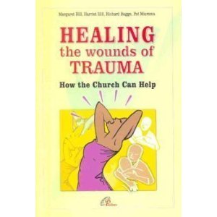

Resources!
http://www.thehopeofsurvivors.com/default.asp
Notes:
D. Langberg; P. Goodyear-Brown; M. Hill et al; P. Kilbourn; A. Schmutzer

Slide 92
Anxiety
Trauma
Depression

Slide 93
Symptom presentation
Chronic panic; depression
Flashbacks and dissociation
Self-doubt & loathing: voiceless
Distrust of others
Withdrawal AND dependency
Impulsivity (behaviors and emotions)
Somatic problems
  Sleep, eating, pains, etc.

Slide 94
In children?
Increased relational confusion
  (no adult perspective to modify experiences)
Inability to predict future
  Hyperactivity; agitation; school problems; emotional shut-down
Decreased capacity to express oneself

Slide 95
2 Trajectories
Safety
Remembering
Mourning/lament
Reconnection
Hope
Silence
Forgetting
Forced reconciliation
Isolation
Fear
Notice: the goal is not the removal of “getting past, over” or removing all signs of abuse
from Janelle Kwee, “The adult survivor” in Schmutzer (Ed) The Long Journey Home, p. 282f

Slide 96
Treatment Overview
Three Phase Protocol
Safety…Memory work…Reconnection
Talking…Tears…Time

Slide 97
Phase one: Safety & stabilization
Foundation for all treatment
Longest phase and vital to positive outcomes
Features
  Alliance building; support networks
  Education about the nature of trauma
  Managing vs. reacting to symptoms

Slide 98
Phase one interventions
Assessment
  for life-threatening issues
  for life-dominating issues
Education
  for skills to manage affective and body symptoms
  for understanding trauma, therapy, and boundaries
Support network development

Slide 99
Phase one goals
Increase self-reflection and compassion for the struggle
Support appropriate boundaries
Decrease therapy interfering behaviors
Increase positive coping skills and support network

Slide 100
Phase one dangers
Diving into trauma work before building coping skills
Failing to return to phase one during trauma memory work
Counselor reactivity to client crises
Counselor controlling behaviors
Counselor enmeshed with client
Mastery over frightening and reactive responses must be attained before proceeding to phase two

Slide 101
Phase two: Processing memories
Memory work done in concert with phase one skills
  Focus: grief, loss, shame, anger rather than anxiety
  Context: the tendency to leave (dissociate from) the pain
  Goal: Small amounts of memory work with frequent self-care and stabilization

Slide 102
Key intervention: Lament
Canonized complaints to God
Lamentations includes
  Complaint against sin and destruction
  Agony over personal/corporate sin (in children of God and heathen)
  Questioning God
  Waiting expectantly for answers
  Worship

Slide 103
Does lament resolve hurt/anger?
Answers from Scripture?
Answers from Science?
Notes:
Snow, McMinn, Bufford & Brendlinger (2011). Resolving anger toward God: Lament as an avenue toward attachment. Journal of Psychology and Theology, 39, 130-142. [study of 192 college students. Lament may increase communion with God but does not seem to decrease anger toward God]

Slide 104
Phase two dangers
Pushing or avoiding the story
Believing that telling the story is what heals
Seeking catharsis alone leads to re-living more than re-telling

Slide 105
Why do memory work?
Memory work is truthfully telling of a silenced narrative
Memory work at the right pace improves client self-efficacy
Memory work tells the whole story
Memory work supports grieving well
Memory work brings faith and experience together

Slide 106
Phase three: Connection and growth
Marital work
Parenting
Conflict resolution
Setting appropriate boundaries
Reconnecting to communities; to purpose and identity beyond “abused”

Slide 107
Counselor Pit-falls
Pushy
  Premature memory work
  Accepting authoritarian stance (benign dictator?)
    Work at client pace, not yours
Not tuned in
  Ignoring basic stabilizing work
  Ignoring in-session dissociation/triggers
    Stay present and in the here/now
Poor boundaries
  Over-identifying with client; enmeshed
  Overwhelmed and burned-out; distancing
    Practice predictable, clear boundaries
Notes:
Watch out for controlling behaviors.

Slide 108
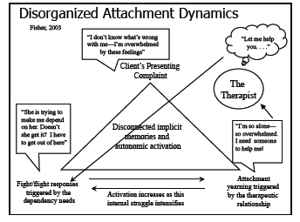
Notes:
This and next slide from Janina Fisher’s 2012 trauma and attachment presentation

Slide 109
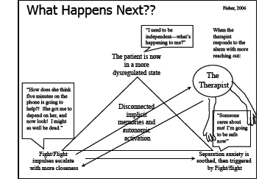


Slide 110
Vicarious trauma
“Trauma is contagious”
  Bearing witness leads to hopelessness, questions of faith, and fear in relationships
  Temptation: withdrawal or intrusive action
VT defined: (Saakvitne & Pearlman)
  transformation of the therapist's inner experience as a result of empathic engagement with another’s trauma
Transforming the Pain

Slide 111
Tend your garden
To last the long haul without damage, tend to:
  Self-care
  Relationships
  Faith

Slide 112
A temptation to avoid self-care?
I find many therapists feel guilty pursuing beauty and peace and order in their own lives...
It is as if somehow they should not have good in their lives while others suffer.
However, the Word of God says that He gives us richly all good things to enjoy.
To turn from such things is to turn from the gifts in His hand.
Notes:
Quotes from Diane Langberg

Slide 113
www.wisecounsel.wordpress.com

Slide 114
It is Well with my Soul
When peace like a river attendeth my way, when sorrows like sea billows roll, whatever my lot, thou has taught me to say, “it is well, it is well with my soul.” (chorus)

Slide 115
It is Well with my Soul
Though Satan should buffet, though trials should come,
let this blest assurance control: That Christ has regarded my helpless estate, and has shed His own blood for my soul. (chorus)

Slide 116
It is Well with my Soul
My sin—O the bliss of this glorious thought, my sin—not in part but the whole, Is nailed to the cross and I bear it no more: praise the Lord, praise the Lord, O my soul. (chorus)

Slide 117
It is Well with my Soul
And, Lord, haste the day when my faith shall be sight, the clouds be rolled back as a scroll, the trump shall resound and the Lord shall descend: “Even so”—it is well with my soul. (chorus)

